Slide 1
Mazinga App
Your ultimate fitness tracking companion

Slide 2
Introduction
Mazinga App revolutionizes fitness tracking by providing users with a comprehensive tool to monitor their health and fitness journey, enabling personalized experiences and effective goal setting.

Slide 3
01
Features

Slide 4
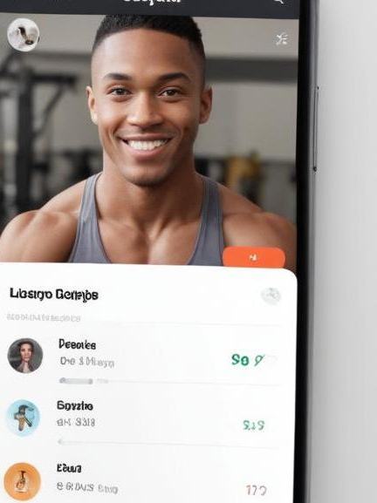
User Profiles
Creating a personalized user profile allows individuals to set their fitness goals, input health metrics, and track progress over time. This feature aids in customization and motivation by tailoring recommendations based on user data.

Slide 5
Activity Tracking
The Mazinga App offers robust activity tracking capabilities, allowing users to log workouts, monitor duration, distance, and calories burned. This feature provides insights into fitness routines, helping users to optimize their training sessions.

Slide 6
Integration with Wearables
Mazinga App seamlessly integrates with various wearable devices, allowing users to sync data such as heart rate, steps taken, and sleep patterns. This integration enhances the user experience by providing comprehensive insights, enabling precise tracking of fitness goals.

Slide 7
02
User Engagement

Slide 8
Goal Setting
The app allows users to set personalized fitness goals based on their individual capabilities and aspirations. Users can select specific targets, whether it's weight loss, muscle gain, or endurance improvement, enhancing motivation and commitment.

Slide 9
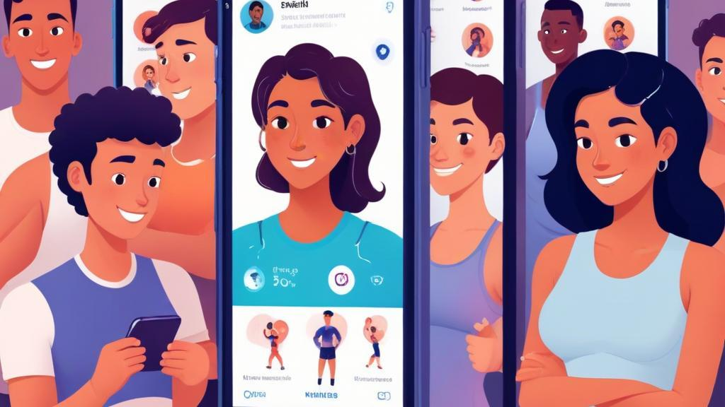
Progress Sharing
Mazinga App encourages social interaction by allowing users to share their fitness milestones and achievements with friends and the community. This feature not only fosters accountability but also inspires others on their fitness journeys.

Slide 10
Gamification Elements
Incorporating gamification, the app features challenges, rewards, and badges for users, transforming fitness into an enjoyable experience. This strategy motivates users to engage regularly with the app and pursue their fitness goals actively.

Slide 11
Conclusions
Mazinga App stands out as a comprehensive fitness tracking solution that not only monitors activities but also actively engages users through gamification, community sharing, and personalized goal settings. This combination ensures users remain motivated on their fitness journeys.

Slide 12
Thank you!
Do you have any questions?
+91 620 421 838

